Slide 1


Disease Prediction Using Machine Learning
Predicting diseases based on symptoms.

Slide 2

Our Team
Pulkit Malik
Sanskar Sengar
Faculty Details
E23CSEU0677
E23CSEU0667
Dr. Sanchali Das

Slide 3
Problem Statement
Accurate disease prediction is crucial.
1
Early Detection
Improve patient outcomes.
2
No Targeted Treatment
Lack of specific healthcare approaches.
3
Resource Allocation
Efficient healthcare system.

Slide 4
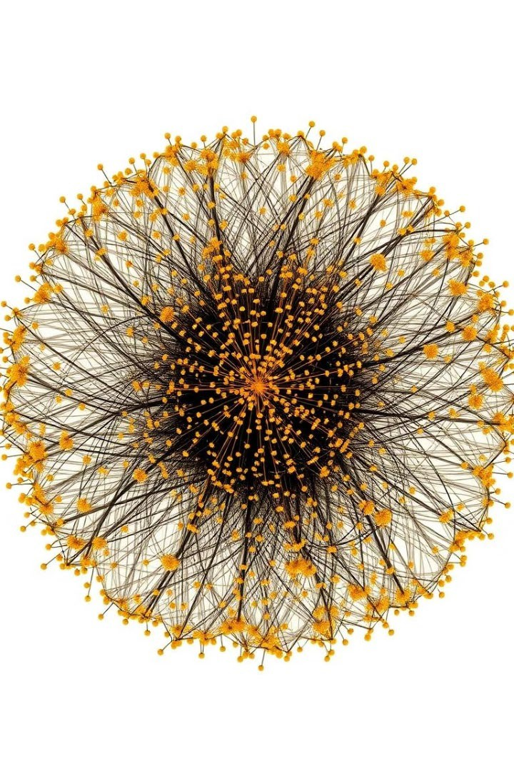
Dataset and Features
The dataset contains 132 features.
Symptom Features
Disease Prognosis
Patient Demographics
Disease Classification

Slide 5
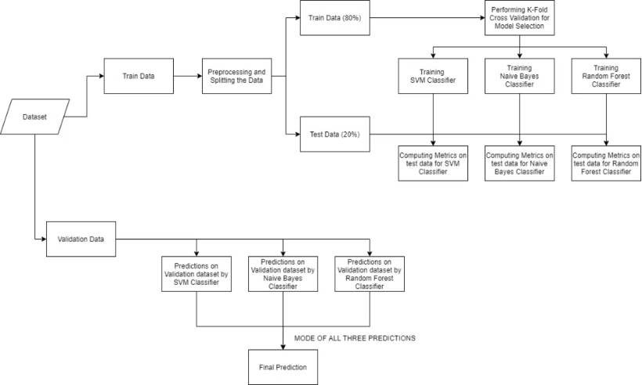
Data Preparation
The dataset used was obtained from Kaggle.
The dataset contains 133 columns, where 132 represent symptoms and one represents disease prognosis.
The target column (prognosis) was encoded using
`LabelEncoder`.

Slide 6
Machine Learning Models
Multiple models were used.
SVC
Naive Bayes
Random Forest
Support Vector Classification (SVC) is a supervised learning model used for classification tasks. It constructs a hyperplane in a multi-dimensional space that optimally separates different classes.
Naive Bayes is a probabilistic classification algorithm based on Bayes' Theorem. It assumes independence among features and is particularly effective for large datasets.
Random Forest is an ensemble learning method that constructs multiple decision trees at training time. It improves classification accuracy by averaging predictions from its diverse set of trees.

Slide 7


Evaluation and Ensemble Model
K-Fold Cross-Validation
K-fold cross-validation was used to evaluate the performance of the machine learning models. The dataset was divided into K subsets, and the models were trained and tested on different combinations of these subsets to assess their generalization ability.
Ensemble Model
The predictions from all three models were combined using the mode of their predictions to improve robustness. This ensemble approach leverages the strengths of each individual model to enhance the overall prediction accuracy.

Slide 8

Prediction Function
A function was created to take input symptoms and predict the disease based on the ensemble model.
The function takes a list of symptoms as input.
The function utilizes the trained ensemble model to classify the disease.
The function returns the predicted disease label.

Slide 9

Key Findings
The machine learning models developed demonstrated impressive accuracy, highlighting significant advancements in our approach.
Outlier Detection
Implemented using both Z-score and IQR methods, these techniques effectively identified and managed anomalies, ensuring data integrity and robustness.
Data Preprocessing
Comprehensive preprocessing steps, including normalization and feature scaling, significantly enhanced model performance, resulting in more reliable predictions.
Model Comparison
Through rigorous evaluation, Random Forest emerged as the top-performing model, consistently achieving higher accuracy compared to other algorithms.

Slide 10

Future Work
Continued research is needed.
Real-Time Prediction
Integrate models into clinical workflow. This involves creating seamless interfaces between predictive algorithms and existing healthcare management systems. The aim is to provide instant insights, thereby enhancing patient care and decision- making processes.
Deep Learning
Explore more complex models. Deep learning techniques can uncover intricate patterns in medical data that are not evident with traditional methods. This approach has the potential to elevate the accuracy of disease predictions and personalization of treatment plans.

Slide 11

Conclusion
Disease prediction with machine learning offers transformative potential in the realm of healthcare.
By accurately predicting diseases in earlier stages, it enables rapid diagnosis and timely interventions, potentially saving countless lives.
Moreover, this technology aids in the development of personalized treatment plans, aligning therapies closely with individual patient needs and genetic profiles.
Overall, the integration of machine learning into healthcare systems promises not just advancements in care quality, but also significant improvements in healthcare logistics and resource allocation.

